Slide 1
Auto Insurance Claim Prediction
Author: Harshil Khara

Slide 2
Problem Statement
As an auto insurance owner, I want to be able to predict which customers are more likely to claim an insurance in the following years. Given the customer data, I want to find out which machine learning models turn out to be the most accurate for prediction.

Slide 3

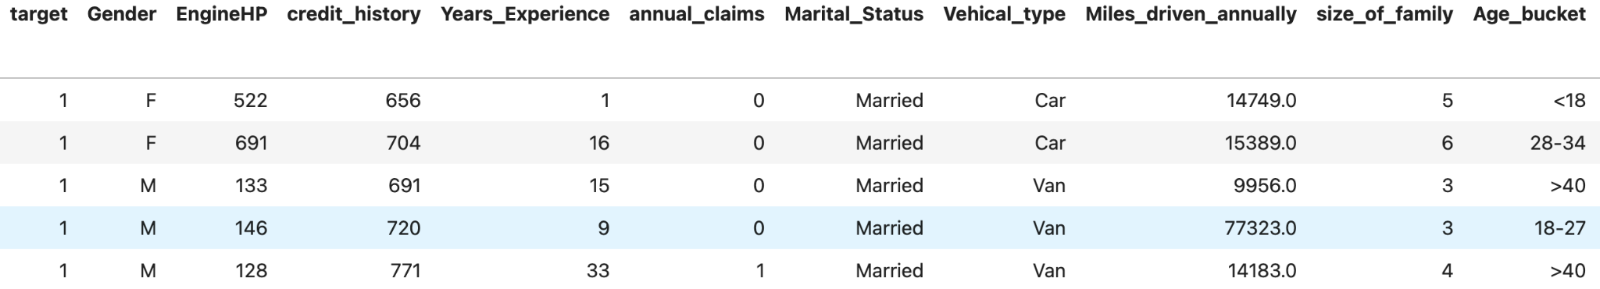
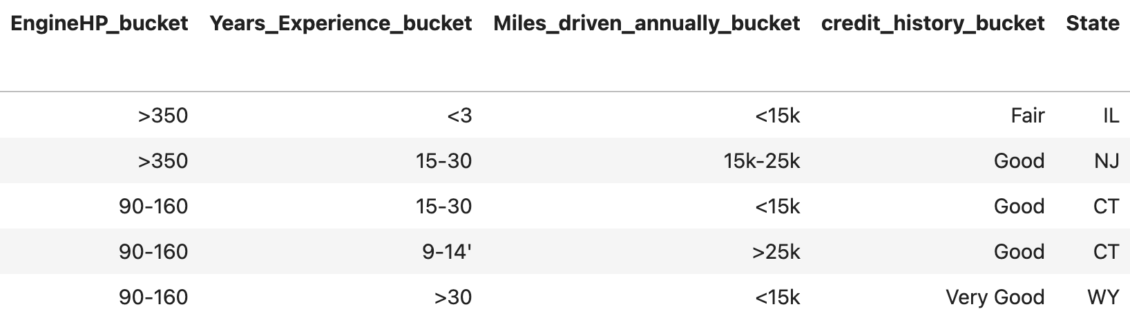
Data Preview

Slide 4
Classifiers Used
K-Nearest Neighbor (KNN)
Random Forest
Decision Tree
Logistic Regression
Support Vector Machine (SVM)
Naive Bayes

Slide 5
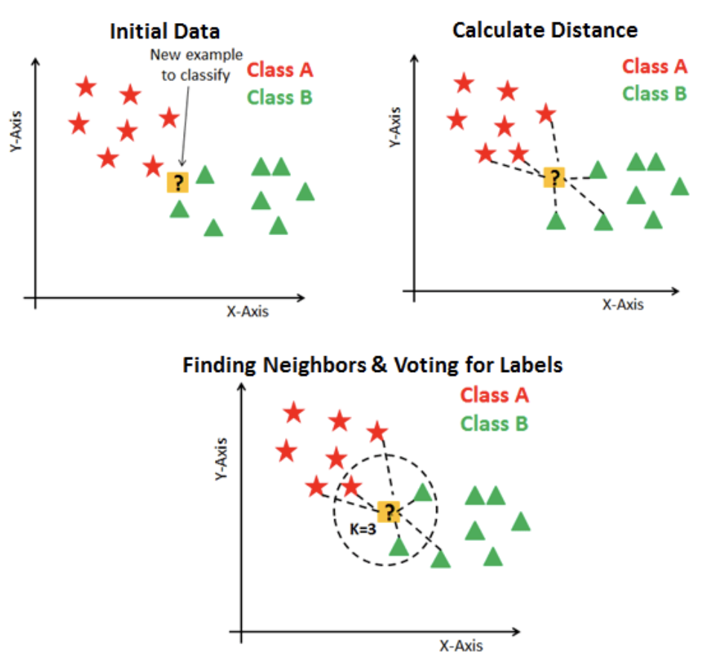
KNN Classifier
The KNN algorithm assumes that similar things exist in close proximity. In other words, similar things are near to each other.
A given object gets assigned to the class most common among its k nearest neighbors where k is a positive integer and typically small.
For my analysis, I chose k = 7, so the values having least distance from nearest 7 values will be taken.
KNN has three basic steps:
Calculate the distance
Find the k nearest neighbors
Vote for classes

Slide 6
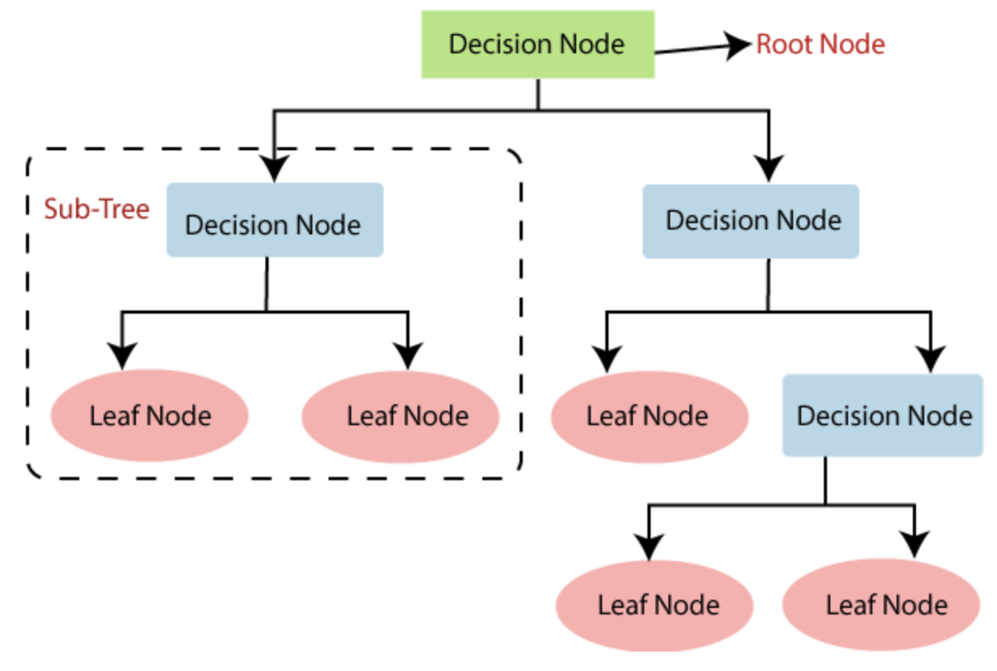
Decision Tree Classifier
A Decision Tree is a tree-like graph with nodes representing the place where we pick an attribute and ask a question, edges represent the answers to the questions asked, and the leaves represent the actual output or class label.
Based on the given features, I used a decision tree with a max depth of 10 to classify whether a given customer will claim insurance or not.

Slide 7
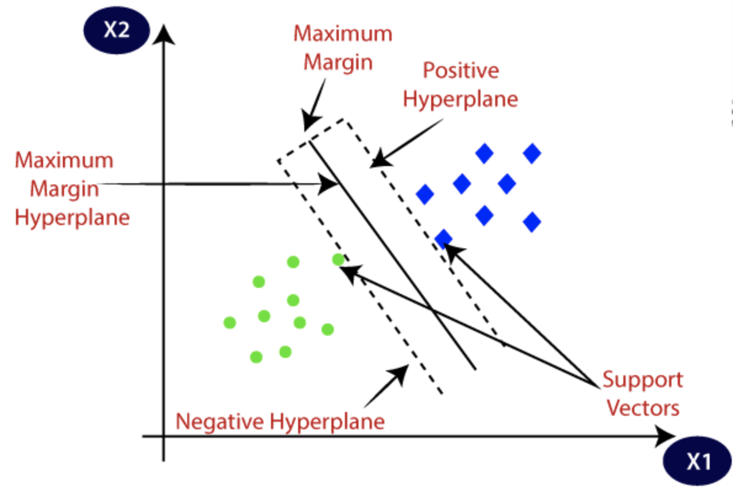
SVM Classifier
The goal of the SVM algorithm is to create the best line or decision boundary that can segregate n-dimensional space into classes to easily classify data points into correct categories. This best decision boundary is called a hyperplane.
I used a Linear SVM with C=500, where ‘C’ tells the SVM optimization how much you want to avoid misclassifying each training example. For large values of C, the optimization will choose a smaller-margin hyperplane.

Slide 8
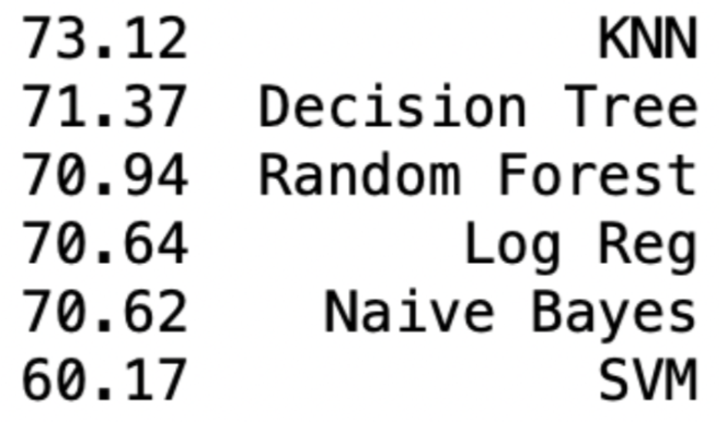
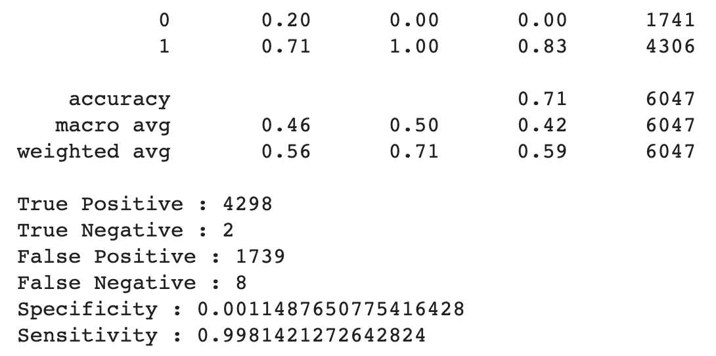
Accuracy Results
We can see that the KNN classifier performed the best, while the SVM classifier performed the worst.
KNN may have benefited from feature selection and an optimized value of k.
And we can say that in cases where the classes are overlapping, linear SVM tends to underperform, but this could be circumvented using non-linear kernels.
KNN Classifier Classification Report

Slide 9

Future Scope
Feature Engineering: Using different combinations of features from the data provided.
Hyperparameter Tuning: Different values for k in the KNN classifier, tuning maximum depths and features in the Decision Tree classifier, using polynomial kernels in the SVM classifier.

